Slide 1
Software Engineering Approach
Lecture – 1
Introduction to Software Engineering Approach (CSE 4658)

Slide 2
Course Details
Credit: 4; Grading Pattern: 6
Software Engineering
What Is Software Engineering? Working Well on Teams, Knowledge Sharing, Engineering for Equity, How to Lead a Team, Leading at Scale, Measuring Engineering Productivity, Style Guides and Rules, Code Review, Documentation, Testing Overview, Unit Testing, Testing Doubles, Larger Testing, Deprecation, Version Control and Branch Management, Code Search, Build Systems and Build Philosophy, Static Analysis, Dependency Management
Text: Software Engineering at Google Lessons Learned from Programming Over Time: Titus Winters, Tom Manshreck, and Hyrum Wright, O’REILLY

Slide 3
Evaluation
INTERNAL
PARTICIPATION | 5
WEEKLY ASSIGNMENTS | 20
MID TERM | 15
INTERNAL TOTAL | 40
EXTERNAL
EXTERNAL TOTAL | 60

Slide 4


Slide 5
Chapter-1
What Is Software Engineering?

Slide 6
Organization of the Structure (Chapter-1)
Software Engineering vs. Programming
Software Characteristics
Software Failure Rate
Software Engineering - defining
Time and Change
Hyrum’s Law
Timeline of the developer workflow
Tradeoffs and Costs
Evolution of Pattern of Technology
Types of Software
Stakeholders in Software Engineering
Software Quality
Software Crisis

Slide 7
Software Engineering vs. Programming
Programming is about writing code. You take a task and write code to solve it.
Software engineering is when you take that piece of code and consider:
  How will this task evolve?
  How will this code adapt to those changes?
  What does this code encourage others to do?
  How does this code encourage other programmers to use it?
  How will I understand this code in 5 months?
  How will a busy team member jumping around grok this?
  What happens when the business becomes bigger?
  When will this code stop being good enough?
  How does it scale?
  How does it generalize?
  What hidden dependencies are there?
  considering the long-term effects of your code. Both direct and indirect.
  You always face the underlying concern of "What's the expected lifespan of this code?".

Slide 8
Program vs Software
Program Software
Usually small in size
Author himself is sole user
Single developer
Lacks proper user interface
Lacks proper documentation
Ad hoc development
Large
Large number of users
Team of developers
UI is an important aspect
Well documented & user-manual prepared
Systematic development
Notes:
8

Slide 9
Software Characteristics
Software is intangible
  Hard to understand development effort
Software is easy to reproduce
  Cost is in its development
  In other engineering products, manufacturing is the costly stage
Software is easy to modify
  People make changes without fully understanding it
Software does not ‘wear out’
  It deteriorates by having its design changed:
    erroneously, or
    in ways that were not anticipated, thus making it complex

Slide 10
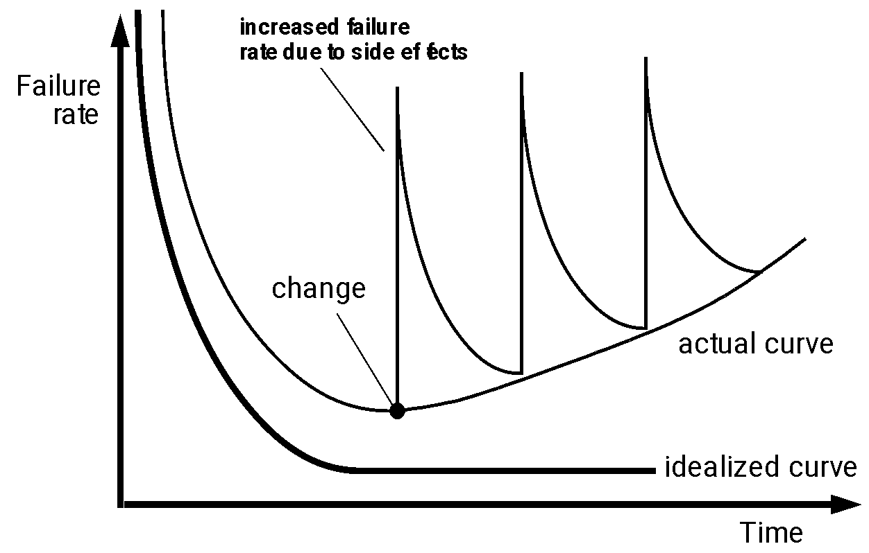
Software Failure Rate

Slide 11
Software Engineering - Defining
Engineering approach to develop software.
  It discusses systematic and cost effective techniques for software development.
The process of solving customers’ problems by the systematic development and evolution of large, high-quality software systems within cost, time and other constraints
The application of a systematic, disciplined, quantifiable approach to the development, operation, maintenance of software; that is, the application of engineering to software. (IEEE)

Slide 12
Software Engineering: A Layered Technology
tools
methods
process model
a “quality” focus
Software Engineering

Slide 13
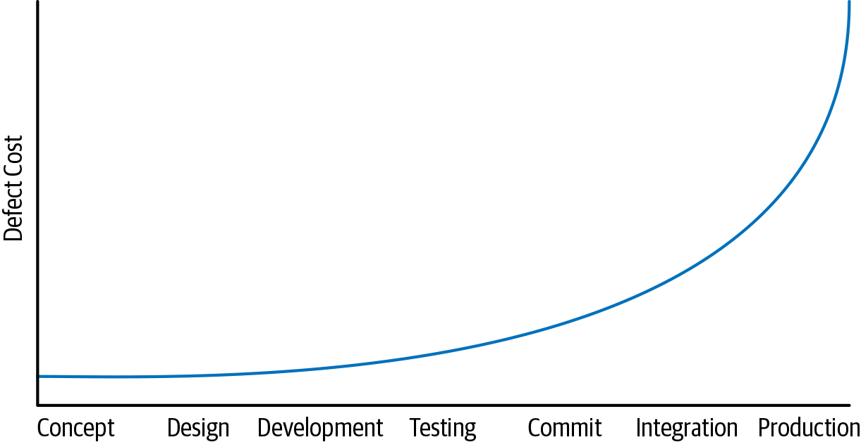
Time and Change
Lifespan and the importance of upgrades

Slide 14
Time and Change
You’re performing a task that hasn’t yet been done for this project;
more hidden assumptions have been baked-in
The engineers trying to do the upgrade are less likely to have experience in this sort of task.
The size of the upgrade is often larger than usual, doing several years’ worth of upgrades at once instead of a more incremental upgrade.

Slide 15
Hyrum’s Law
If you are maintaining a project that is used by other engineers, the most important lesson about “it works” versus “it is maintainable” is what we’ve come to call Hyrum’s Law:
With a sufficient number of users of an API, it does not matter what you promise in the contract: all observable behaviours of your system will be depended on by somebody.

Slide 16
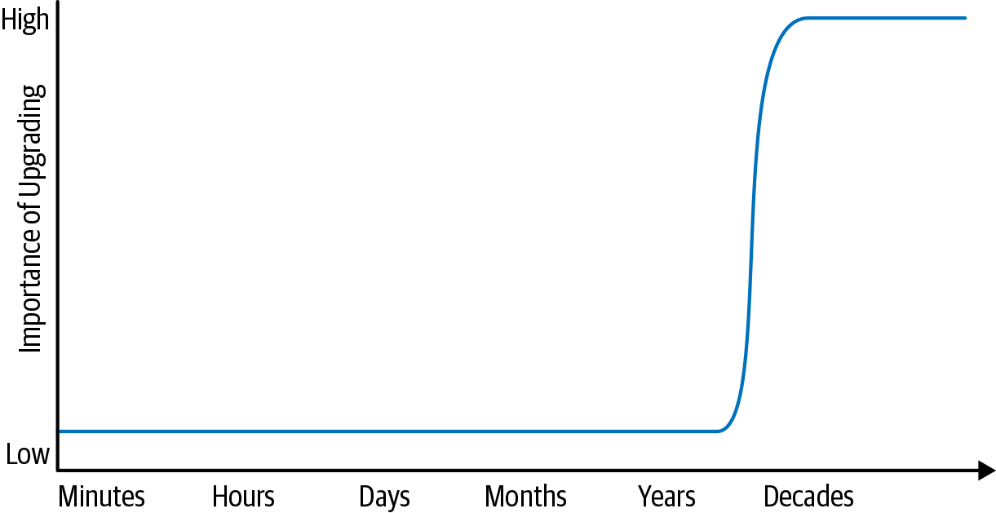
Timeline of the developer workflow
Timeline of the developer workflow

Slide 17
Efforts and Costs
“Cost” roughly translates to effort, and can involve any or all of these factors:
Financial costs (e.g., money)
Resource costs (e.g., CPU time)
Personnel costs (e.g., engineering effort)
Transaction costs (e.g., what does it cost to take action?)
Opportunity costs (e.g., what does it cost to “not” take action?)
Societal costs (e.g., what impact will this choice have on society at large?)

Slide 18
Evolution Pattern
Every technology in the initial years starts from an art.
Over time, it graduates to a craft and finally emerges as an engineering discipline.
  Example: Iron making, paper making, software development, or building construction.
i.e. say iron making:
  The esoteric knowledge got transferred from generation to generation as a family secret
  Slowly a tradesman shared their knowledge with their apprentices and the knowledge pool continues to grow.
  Much later, through a systematic organization and documentation of knowledge, and incorporation of scientific basic, modern steel making technology emerged.

Slide 19
Evolution of Pattern of Technology
Engineering
Technology
Esoteric Past
Experience
Craft
Systematic Use of Past
Experience and Scientific Basis
Unorganized Use of
Past Experience
Art
Time

Slide 20
Types of Software - I
Customized
  For a specific customer according to requirement.
Generic
  Used by a diverse range of customers
  Sold on open market (Ms. Windows, Oracle, …)
  Often called
    COTS (Commercial Off The Shelf)
    Shrink-wrapped
Embedded
  Built into hardware
  Hard to change

Slide 21
Types of Software - II
Real time software
  E.g. control and monitoring systems
  Must react in time
  Safety often a concern
Data processing software
  Used to run businesses
  Accuracy and security of data are key
Some software has both aspects

Slide 22
Generic versus Custom S/W
Generic Custom
The specification is owned by the product developer.
The developer can quickly decide to change the specification in response to some external change.
Users of generic products have no control over the software specification so cannot control the evolution of the product.
The developer may include/exclude features and change the user interface which may affect user’s business processes and add extra training costs when new versions of the system are installed. Again it may limit the customer’s flexibility to change their own business processes.
The specification is owned and controlled by the customer as the domain, requirement and environment being unique to the customer.
changes have to be negotiated between the customer and the developer and may have contractual implications.
Notes:
22

Slide 23
Quiz - I
Classify the following software according to whether it is likely to be custom, generic or embedded (or some combination); and whether it is data processing or real-time.
  A system to control the reaction rate in a nuclear reactor.
  A program that runs inside badges worn by nuclear plant workers that monitors radiation exposure.
  A program used by administrative assistants at the nuclear plant to write letters.
  A system that logs all activities of the reactor and its employees so that investigators can later uncover the cause of any accident.
  A program used to generate annual summaries of the radiation exposure experienced by workers.
  An educational web site containing a Flash animation describing how the nuclear plant works.
Cust & RT, Embd & RT, Gen and RT, Gen and DP, Cust and DP, Cust and RT

Slide 24
Stakeholders in Software Engineering
Users
  Those who use the software
Customers
  Those who pay for the software
Software developers
Development Managers
All four roles can be fulfilled by the same person

Slide 25
Case Study: ATM stake holders
Bank customers
Representatives of other banks
Bank managers
Counter staff
Database administrators
Security managers
Marketing department
Hardware and software maintenance engineers
Banking regulators

Slide 26
Software Quality
Usability
  Users can learn it fast and get their job done easily
Efficiency
  It doesn’t waste resources such as CPU time and memory
Reliability
  It does what it is required to do without failing
Maintainability
  It can be easily changed
Reusability
  Its parts can be used in other projects, so reprogramming is not needed

Slide 27
Quiz - II
Find most and the least important attributes for each of the following systems.
  A web-based banking system, enabling the user to do all aspects of banking on-line.
  An air traffic control system.
  A program that will enable users to view digital images or movies stored in all known formats.
  A system to manage the work schedule of nurses that respects all the constraints and regulations in force at a particular hospital.
  An application that allows you to purchase any item seen while watching TV.
a - rel, eff, b- rel, reusa, c- usa, eff, d- maint, reusa , e- maint, eff

Slide 28
Software Quality and the Stakeholders
Customer:
solves problems at an acceptable cost in terms of money paid and resources used
User:
easy to learn;
efficient to use;
helps get work done
Quality Software
Developer:
easy to maintain;
easy to design;
easy to reuse its parts
Development manager:
pleases customers
sells more and costing less to develop and maintain
Notes:
28

Slide 29
Software Quality: Conflicts and Objectives
The different qualities can conflict
  Increasing efficiency can reduce maintainability or reusability
  Increasing usability can reduce efficiency
Setting objectives for quality is a key engineering activity
  You then design to meet the objectives
  Avoids ‘over-engineering’ which wastes money
Optimizing is also sometimes necessary
  e.g. obtain the highest possible reliability using a fixed budget

Slide 30
Quiz- III
How do you think each of the four types of stakeholders would react in each of the following situations?
Problem: A new system that will completely automate the work of one individual in the customer’s company.
  Case a:
  You discover that the cost of developing the system would be far more than the cost of continuing to do the work manually, so you recommend against proceeding with the project.
  Case b: You implement a system according to the precise specifications of a customer.
  However, when the software is put into use, the users find it does not solve their problem.

Slide 31
Software Crisis
Software products:
  fail to meet user requirements.
  frequently crash.
  expensive.
  difficult to alter, debug, and enhance.
  often delivered late.
  use resources non-optimally.
  Relative Cost of Hardware and Software

Slide 32
Software Crisis
Relative Cost of Hardware and Software
Hw cost
Sw cost
1960
Year
2016
Imagine: When you buy a software, the hardware on which the software runs would come free with the software!!!

Slide 33
Factors contributing to the software crisis
Larger problems
Lack of adequate training in software engineering
Increasing skill shortage
Low productivity improvements

Slide 34
Thank You

